Slide 1
Project of Information Security
Deffie HellMan Key Exchange simulator
Group Members:
Mubashar Munir 48
Bilal Nasir 06
Abdul Saboor 40
Rehmatullah 56
Mairaj 46
Submitted To : Dr. Rabia Riaz
Class: BS CS V (A)

Slide 2
Problem Statement
Traditional communication over a network is insecure because attackers can intercept messages and steal secret keys.
There must be a way for two parties to generate a shared secret key without sending it directly.
The problem:
How can Alice and Bob communicate securely over an insecure channel?
How can they agree on a shared key while preventing eavesdroppers?
This project addresses this problem by simulating a secure key exchange using the Diffie–Hellman algorithm

Slide 3
Objectives of the Project
To simulate how Diffie–Hellman key exchange works in real time
To visually demonstrate public key generation and exchange
To validate prime number p and primitive root g
To generate a shared secret key securely
To encrypt and decrypt a message using the shared key
To provide a user-friendly GUI for better understanding

Slide 4
Background / Related Concepts
Cryptography: Techniques for secure communication
Prime Numbers: Essential for modular arithmetic
Primitive Root: Generates all values modulo p
Modular Exponentiation: Used for generating public and secret keys
Diffie–Hellman Algorithm: Enables secure key exchange
Tkinter: Python GUI library
Canvas Animation: Used for public key movement visualization

Slide 5
Proposed Solution / Project Overview
We developed a graphical simulator where:
User enters a prime number p and primitive root g
Alice and Bob enter their private keys
Program automatically generates their public keys
Public keys are exchanged using animation
Shared secret key is computed on both sides
User enters a message to encrypt
The message is encrypted and decrypted using the shared key
This solution visually explains end-to-end secure key generation.

Slide 6
Tools & Technologies Used
Programming Language: Python
GUI Framework: Tkinter
Animation: Tkinter Canvas + Threading
Logic: Modular arithmetic, exponentiation
Libraries:
  threading
  time
  math (for prime & primitive root checks)

Slide 7
Algorithm / Logic
Diffie–Hellman Algorithm:
Choose p (prime) and g (primitive root)
Alice selects private key a
Bob selects private key b
Alice computes A = gᵃ mod p
Bob computes B = gᵇ mod p
Exchange A ↔ B
Alice computes K = Bᵃ mod p
Bob computes K = Aᵇ mod p
Both obtain the same shared key K

Slide 8
Results & Output
Our simulator successfully demonstrates:
Real-time validation of prime and primitive root
Correct generation of public keys
Smooth animation of key exchange
Same shared key generated on both sides
Message encrypted and decrypted correctly
Clear visual representation of cryptographic process

Slide 9
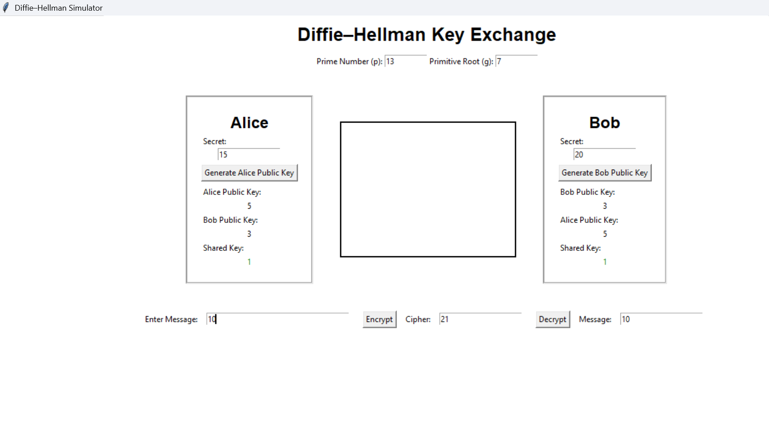
Output

Slide 10
Performance Analysis / Evaluation
Accuracy:
  Correct prime & primitive root detection
  Shared key always matches on Alice and Bob sides
Efficiency:
  Fast calculation using modular exponentiation
User Experience:
  Easy to use
  Clean interface with animations
Reliability:
  No mismatch in keys across multiple tests

Slide 11
Challenges Faced
Implementing accurate primitive root validation
Managing animations without freezing the GUI
Synchronizing exchange animations with key calculations
Designing clear and user-friendly layout
Ensuring encrypted message displays correctly

Slide 12
Limitations of the Project
Only supports small values of p (not industry-level)
Encryption is simplified for demonstration
Interface is limited to desktop environments
Does not include real cryptographic libraries
No network-based real communication — simulation only

Slide 13
Conclusion
The project successfully demonstrates how secure key exchange works using the Diffie–Hellman algorithm.
It provides a complete visual learning tool to understand:
Key generation
Key exchange
Shared secret creation
Message encryption and decryption
The simulator meets the learning objectives and functions accurately

Slide 14
References
William Stallings — Cryptography & Network Security
Behrouz Forouzan — Cryptography & Network Security
Python Documentation
Tkinter Official Documentation
Online resources & tutorials related to Diffie–Hellman

